Slide 1


Percival Lucena IBM Research
Blockchain Technology Details
© 2016 IBM Corporation
Page
24
Notes:
Blockchain is a new-style distributed-database technology that enables enterprises to interact more efficiently and securely
Blockchain was created for enterprise applications with a focus on privacy, confidentiality, auditability, performance and scalability.
Blockchain must be permissioned to ensure greater trust across members, while enabling more optimized forms of consensus which avoids members need to mine, which comes are great cost in compute power and performance.
Blockchain must be extensible to enable experimentation that will lead to innovations in consensus algorithms, storage, integration and performance.

Slide 2

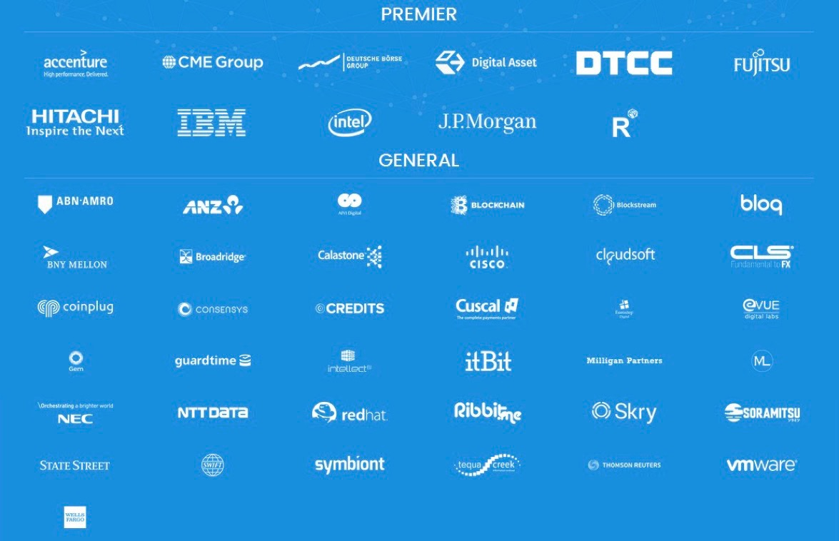


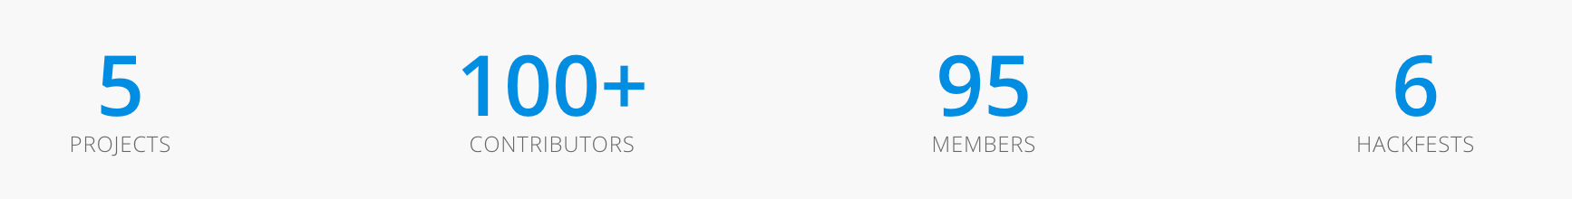
The Hyperledger Project
Open Source Open Standard Open Governance
Fabric
R3 corda
Sawtooth Lake
Brian_Behlendorf
ASF founder Executive Director
Notes:
The Linux Foundation partners with the world's leading developers and companies to solve the hardest technology problems and accelerate open technology development and commercial adoption.The Linux Foundation is home to Linux creator Linus Torvalds and lead maintainer Greg Kroah-Hartman and provides a neutral home where Linux kernel development can be protected and accelerated for years to come.
The Hyperledger Project is a collaborative effort created to advance blockchain technology by identifying and addressing important features for an enterprise-class, cross-industry open standard for distributed ledgers that can transform the way business transactions are conducted globally.
The Hyperledger Fabric, IBM's contribution to the Hyperledger Project, is a modular and scalable protocol architecture for creating blockchain networks

Slide 3



Hyperledger Offerings
HYPELEDGER DOCKER
https://hub.docker.com/u/ibmblockchain/?cm_mc_uid=&cm_mc_sid_50200000=1465483110
LINUX INSTALL
https://github.com/hyperledger/fabric
Managed Service on IBM Cloud
Your private Blockchain network in 1-click
Learn with sample applications
Develop your own Smart Contracts
BLUEMIX SERVICE
https://console.ng.bluemix.net/catalog/services/blockchain/
Blockchain

Slide 4

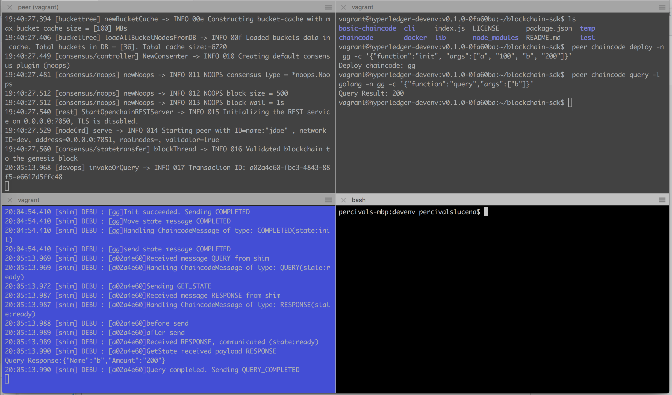


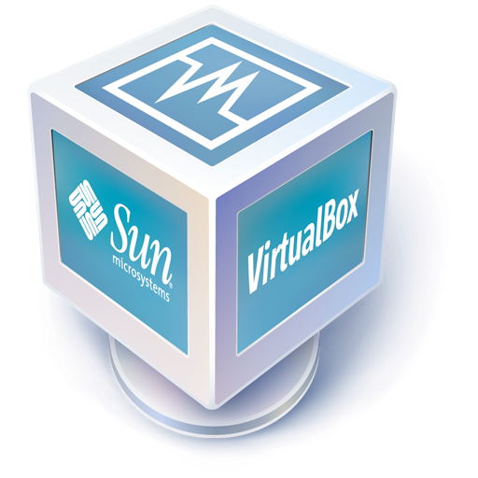
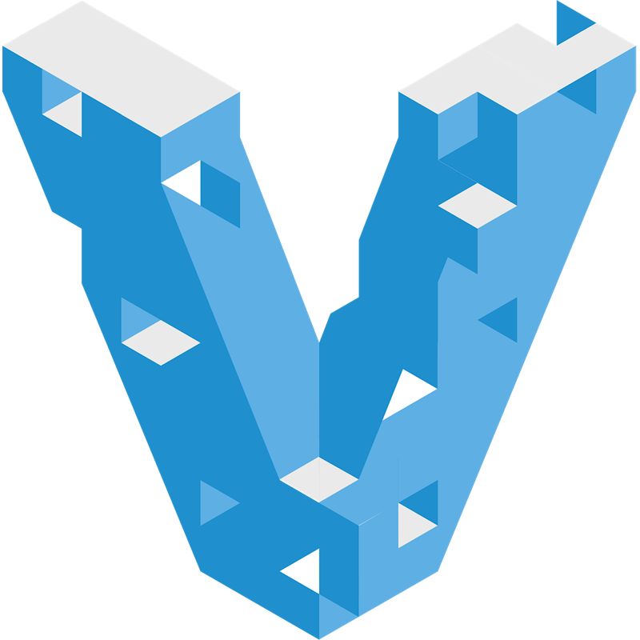
Systems Integration
Information Duplicates/Inconsitency
VAGRANT INSTALL – 0.61 BRANCH
Hyperledger CLI

Slide 5
Systems Integration
Information Duplicates/Inconsitency
DOCKER INSTALL – 0.61 BRANCH
peer node peer
peer

Slide 6
Systems Integration
Information Duplicates/Inconsitency
Docker
http://hyperledger-fabric.readthedocs.io/en/latest/Setup/Chaincode-setup/#option-2-docker-for-mac-or-windows
git clone http://github.com/plucena/smartcontracts
cd docker
docker pull hyperledger/fabric-peer:latest
docker pull hyperledger/fabric-membersrvc:latest
docker-compose up

Slide 7
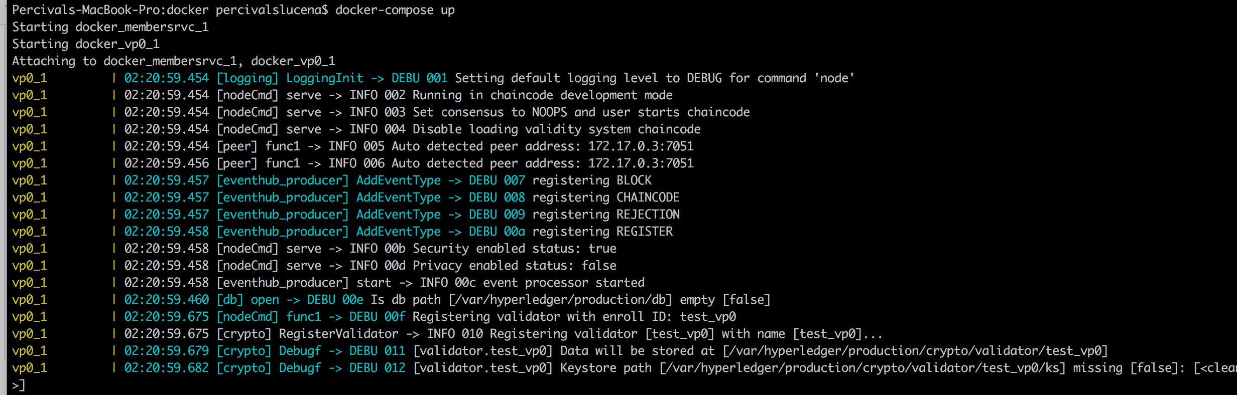
Systems Integration
Information Duplicates/Inconsitency
DOCKER INSTALL – 0.61 BRANCH

Slide 8
Systems Integration
Information Duplicates/Inconsitency
DOCKER REST INTERFACE

Slide 9
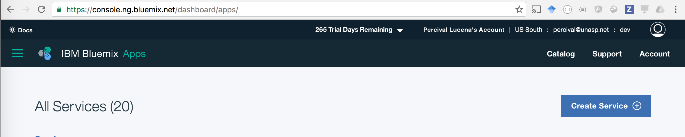
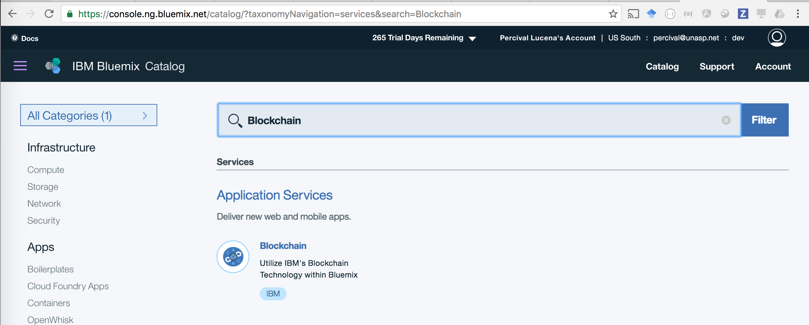
Hyperledger Service

Slide 10
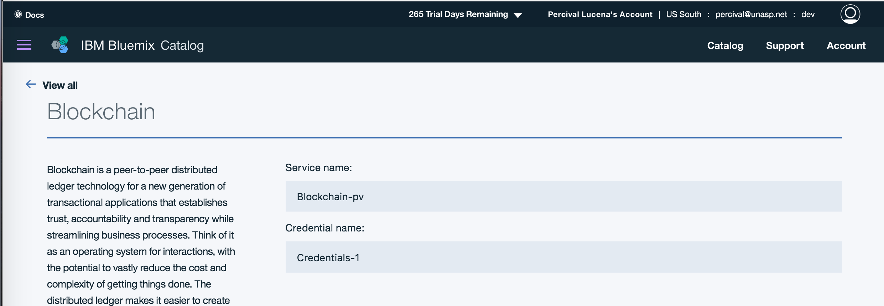
Hyperledger Service

Slide 11
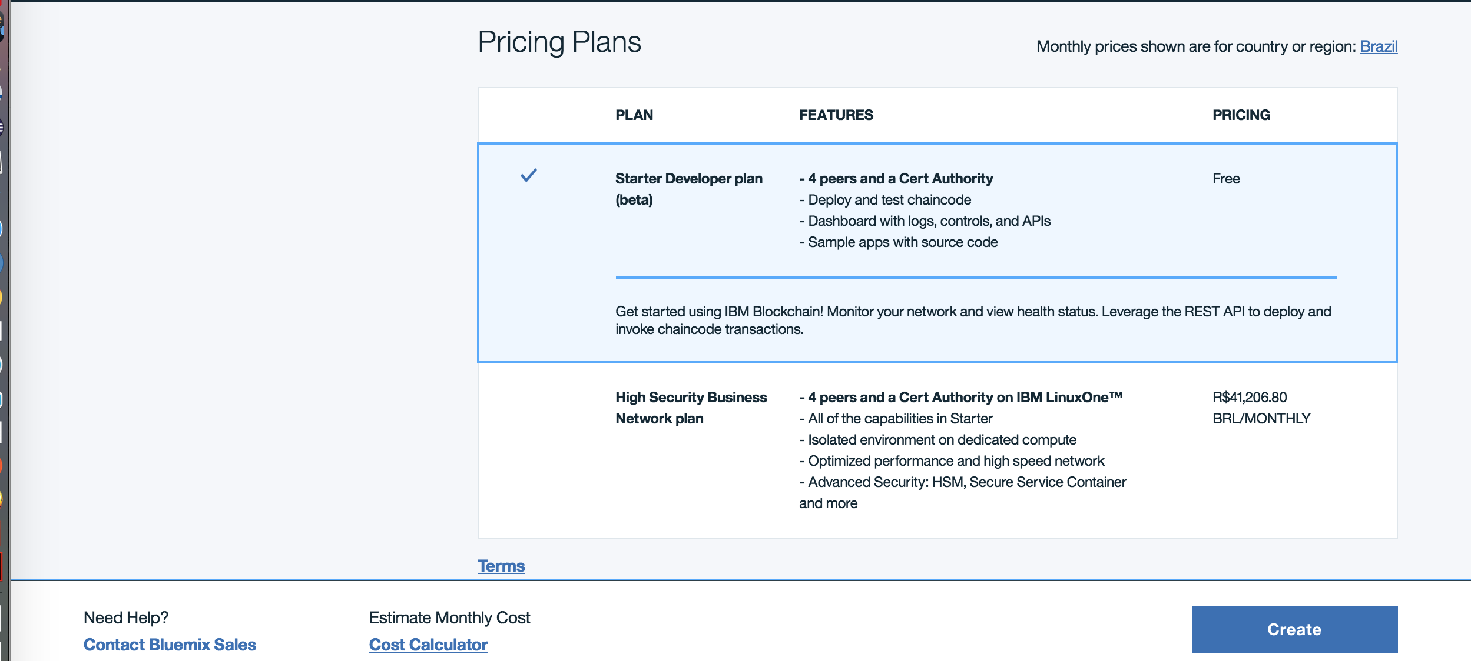
Hyperledger Service

Slide 12
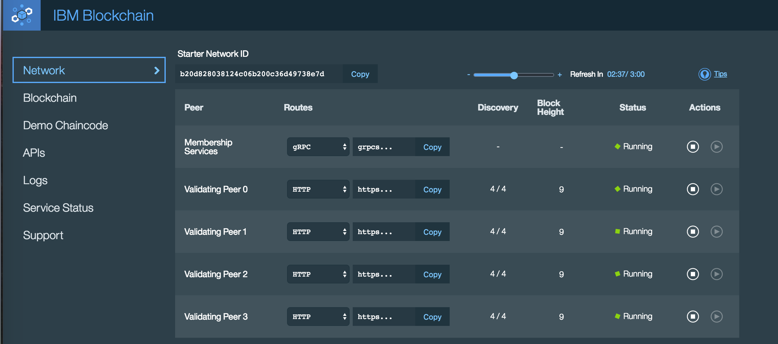
Hyperledger Service

Slide 13
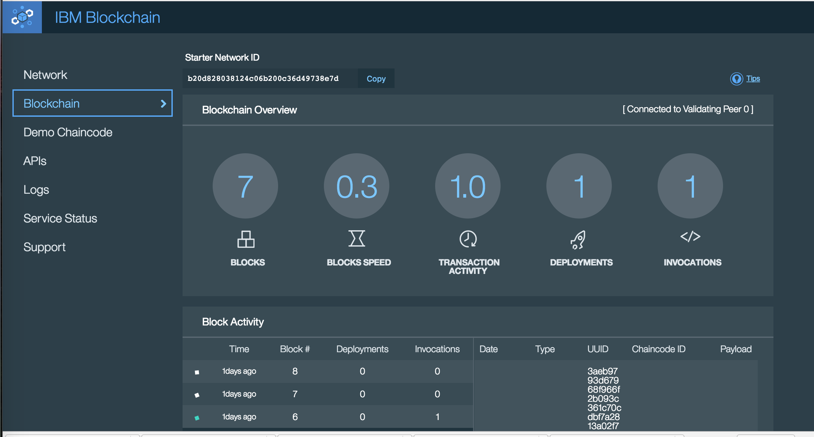
Hyperledger Service

Slide 14
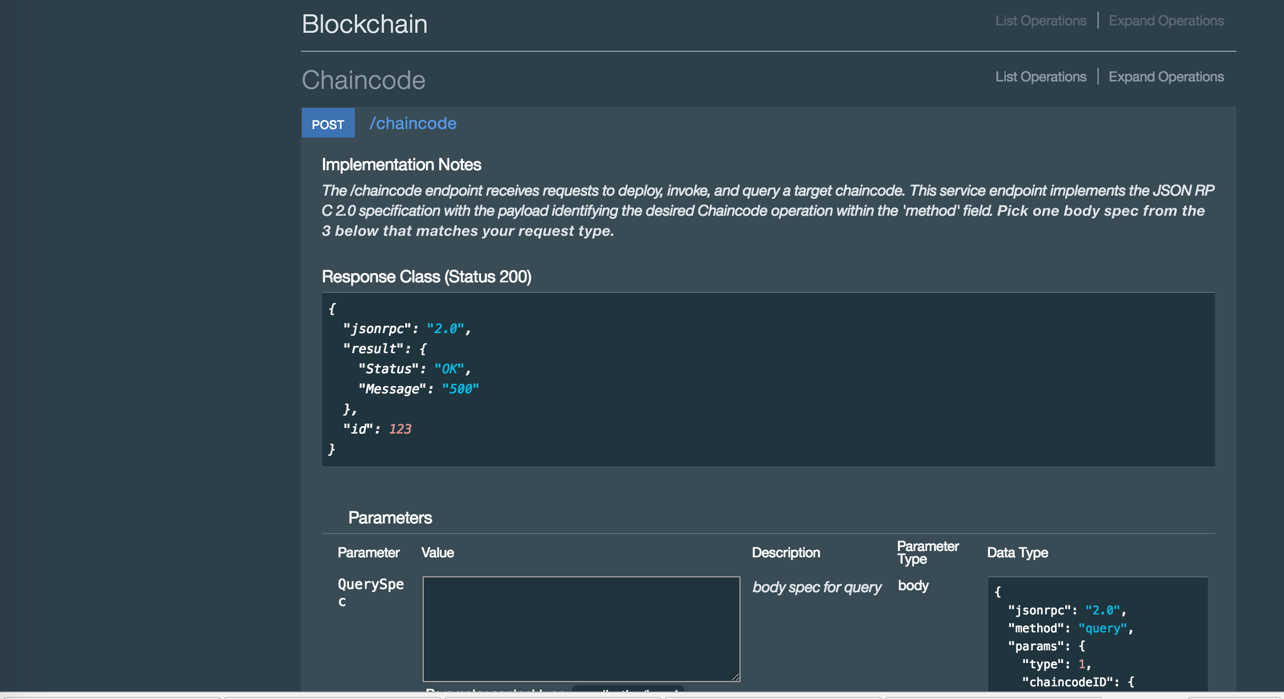
Hyperledger Service

Slide 15
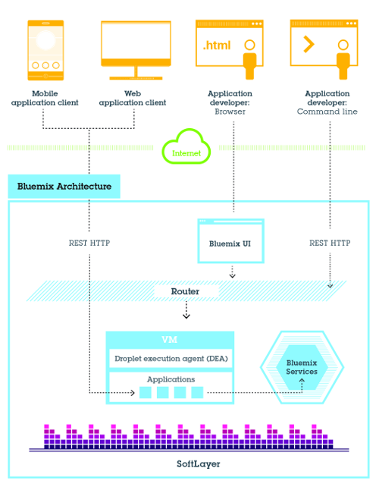


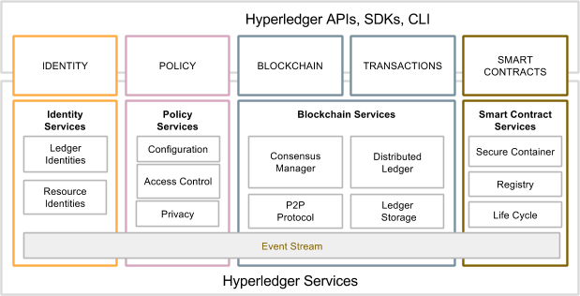
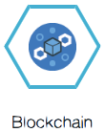
Architecture – Blockchain Platform
Run your own application on any runtime available
API based
Enterprise Grade Security
No need to worry about infrastructure and base ledger network
Same code as publicly available
IBM Blockchain also available on DockerHub
IBM blockchain on Dedicated Cloud
Notes:
Blockchain architecture on bluemix
Blockchain Image on DOCKERHUB

Slide 16
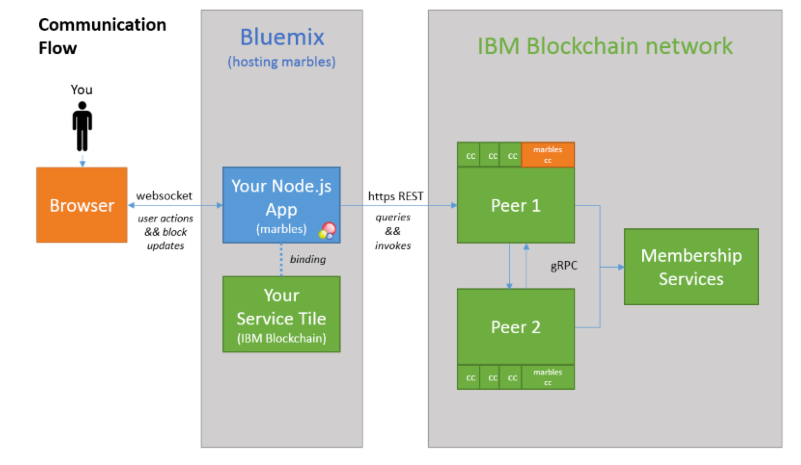
Systems Integration
Information Duplicates/Inconsitency
Hyperledger Service

Slide 17
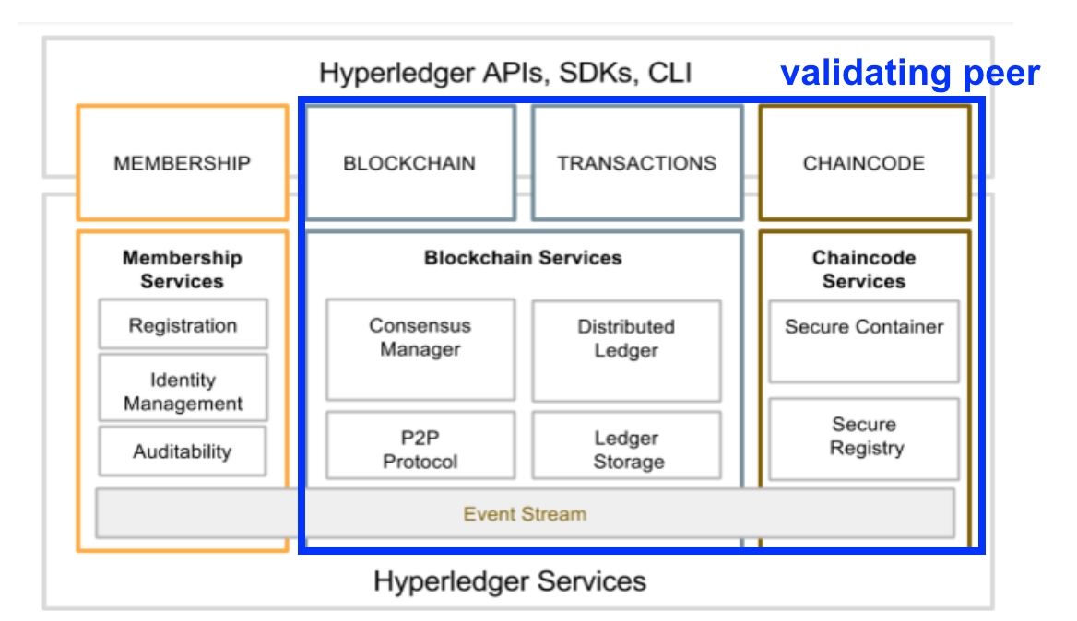

Hyperledger – Architecture 0.6
Notes:
1. Membership Service - Register Users who have access to invoke (execute), query, deploy smart contracts on blockchain on validating peers 2. Blockchain network is usually composed of a Membership services and a set (usually 4 or more validating peers)
3. Consensus Manager - PBFT, SimpleBFT, pluggable Proof of Stake
4. P2P Protocol - GRPC
5. Ledger Storage - Key-pair - world state - RocksDB
6. Secure Container - Execute GO Smart Contracts

Slide 18
Hyperledger – NEW Architecture
Notes:
1. Membership Service - Register Users who have access to invoke (execute), query, deploy smart contracts on blockchain on validating peers 2. Blockchain network is usually composed of a Membership services and a set (usually 4 or more validating peers)
3. Consensus Manager - PBFT, SimpleBFT, pluggable Proof of Stake
4. P2P Protocol - GRPC
5. Ledger Storage - Key-pair - world state - RocksDB
6. Secure Container - Execute GO Smart Contracts

Slide 19
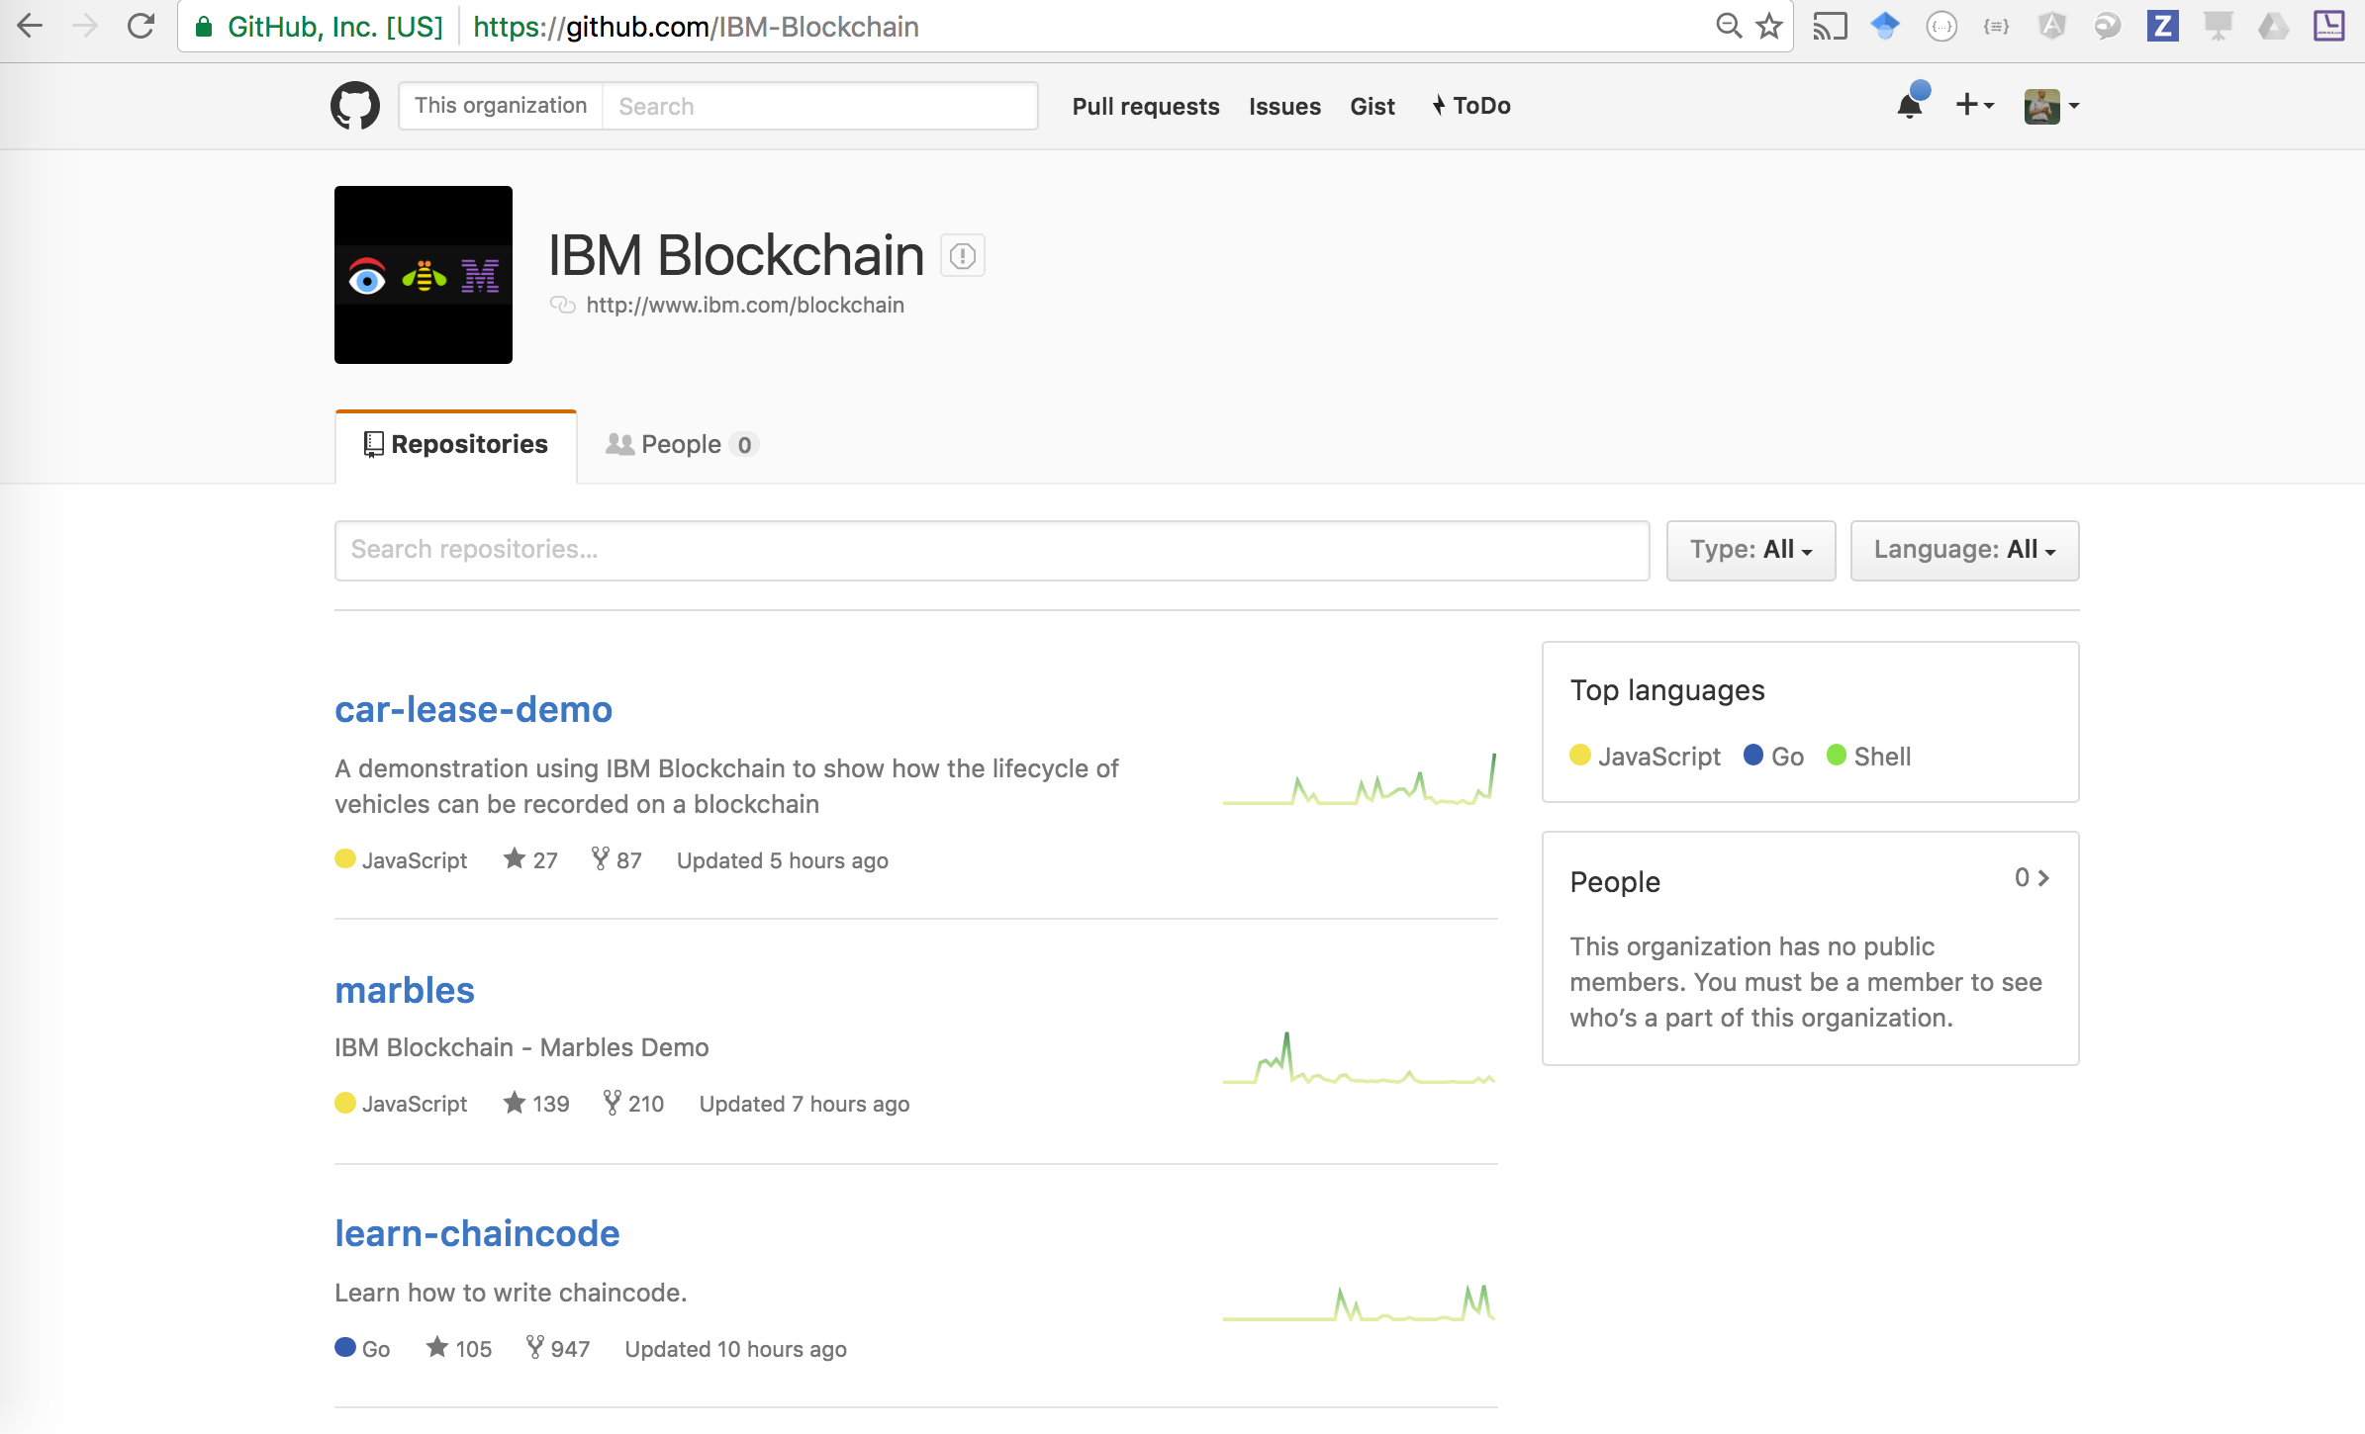
Systems Integration
Information Duplicates/Inconsitency
Where do I start? —-> SAMPLE APPS

Slide 20
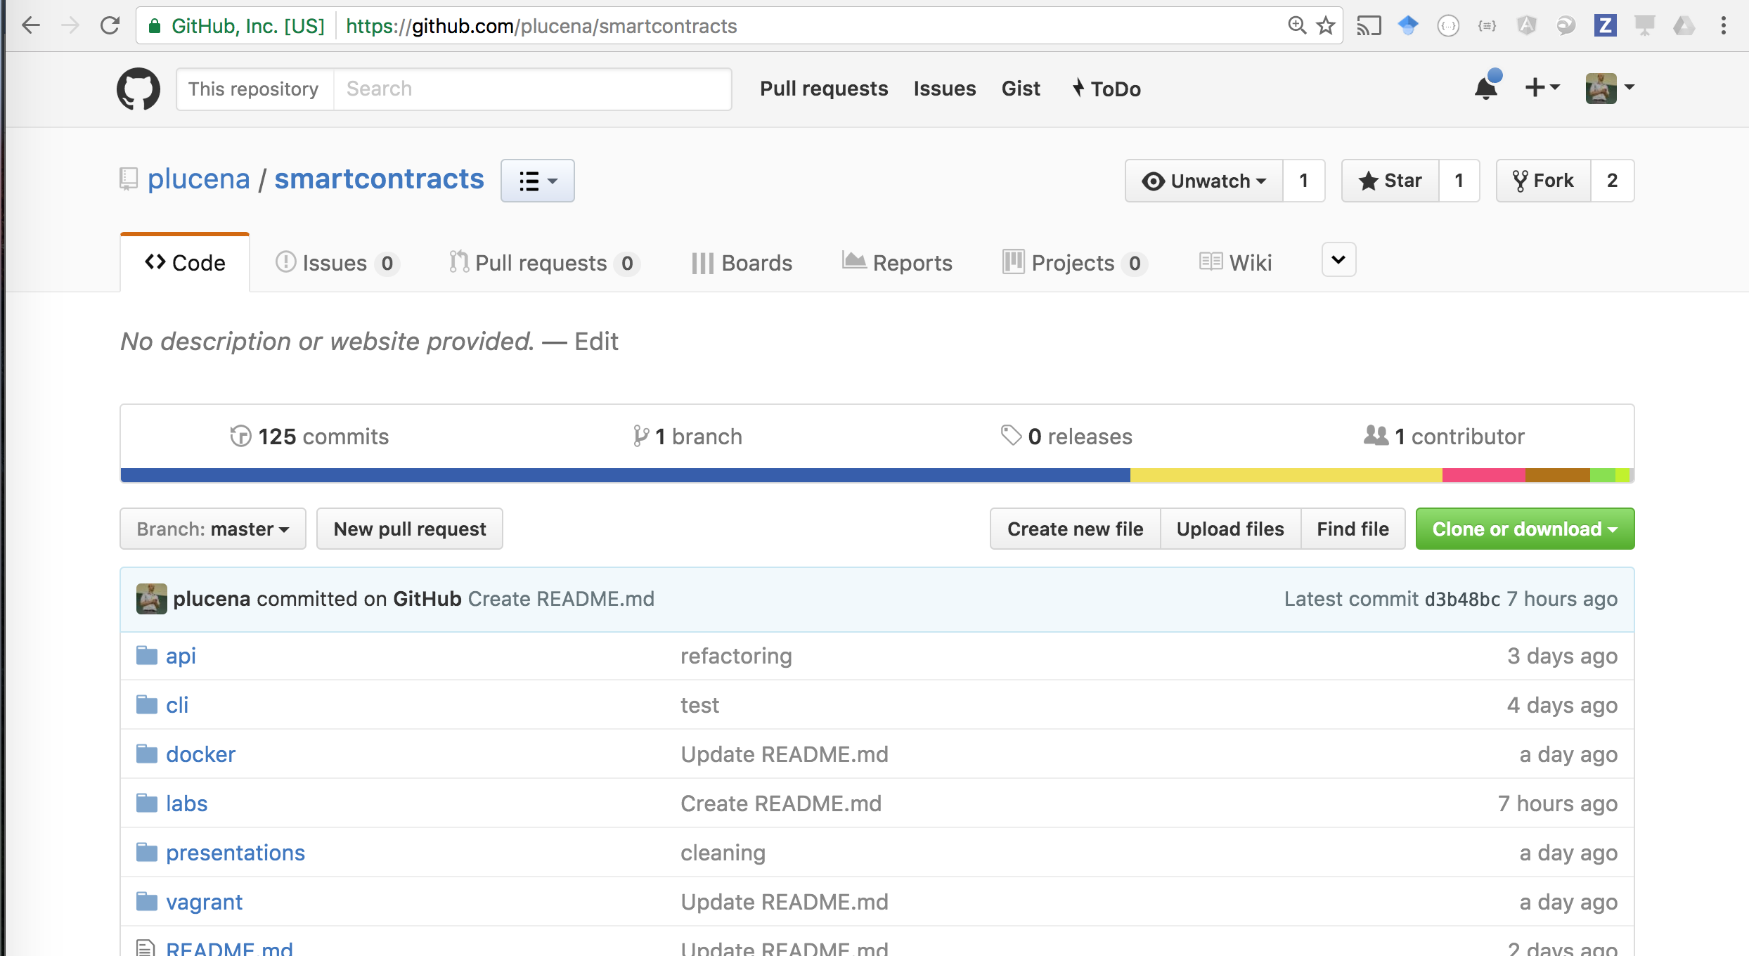
Systems Integration
Information Duplicates/Inconsitency
Where do I start? —-> TUTORIALS

Slide 21
Introduction
Blocks of Transactions
Ledger
Block 13
Block 11
Block 12
Block 13
Block 12
Block 11
Proof of work:
0000005647kjp
Previous block:
000000432qrza1
Proof of work:
000000ahpoka9
Previous block:
0000005657kjp
Proof of work:
00000090b41bx
Previous block:
000000ahpoka9
Time
Transaction
lk54lfvx
Transaction
dd5g31bm
Transaction
94lxcv14
Transaction
09345w1d
Transaction
22qsx987
Transaction
abb7bxxq
Transaction
vc4232v32
Transaction
001hk009
Transaction
34oiu98a
Blocks of Transactions

Slide 22

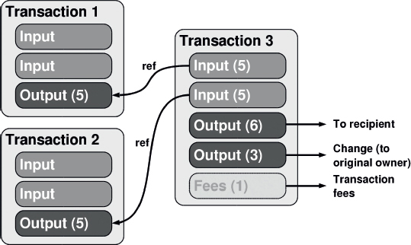
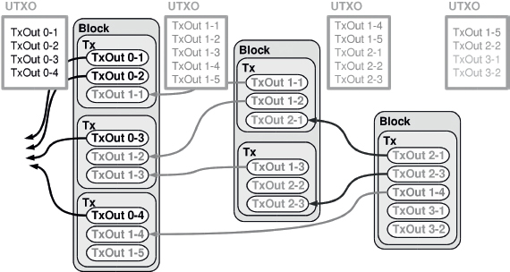
Consensus
Notes:
Transactions são compostas de uma lista de entradas (TxIn) e uma lista de saidas (TxOut). Cada saida (TxOut) possuí : um valor e endereço bitcoin do recipiente O endereço é derivado da chave pública do recipiente da transação. Apenas o dono da chave primária correspondente aos fundos de entrada pode assinar a transação usando a chave privada.
A transação é então enviada para algum nó da rede que verificarará no UXTO se a transação é valida e avisará os outros nós da rede. A transação é a adicionada a um novo bloco de transação (blockchain) quando algum miner descobre o noonce (ocorre cada 10 minutos, a dificuldade da rede aumenta para manter 10 min)

Slide 23
Consensus
Proof of Work
Transactions to be processed
Transactions already validated (and in the chain)
Node
....
Process work to validate transactions
Retrieve pending transactions
Process work
Broadcast that work is completed
Write transaction into the blockchain if transaction is valid for majority of nodes
Node
Node
Node
...
Notes:
Proof of work is a consensus technique used in blockchain implementations to check which blocks can be recorded in the chain. Each node in the network needs to perform a work before telling the other nodes that the former has validated it (worked in the problem). A key aspect of Proof-of-Work is that it takes CPU effort to perform the work, but it is straightforward to validate that the work was done. If the majority of the nodes executed the work and they generated the same result, a consensus is achieved and the block is written in the chain.

Slide 24
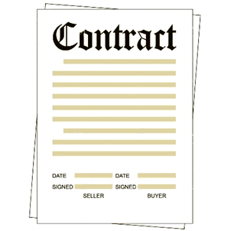
Smart contracts Overview 2
Used to define Trusted participant (roles), e.g.
a) Manufacturer
b) Dealer
c) Lease Company
d) Regulator etc
Used to define a Vehicle (in the Car Leasing demo)
a) VIN
b) Owner details
c) Registration
d) Make
e) Model
f) Scrapped Status
Where Logs are defined. Examples:
a) Create Vehicle
b) Transfer Vehicle
c) Update Vehicle
d) Scrap Vehicle
Restricts “who” can do “what”
Notes:
In the first version of the IBM Blockchain Asset Transfer Demo, the Fabric used to construct the demo does not have any “Member Services” feature. For example there was no way of defining a role for a user or to restrict what that user could do within the demo.
The IBM Blockchain Asset Transfer Demo uses a Smart Contract to assign Accounts used in the demo to have specific roles and in turn define what the Account was allowed to do in terms of business logic. So for example a Manufacturer can transfer a vehicle to a Dealer, but not directly to a Lease Company.
A second Smart Contract is used within the demo to define a Vehicle. Attributes of a “Vehicle Template” for example the assumption is made that all vehicles have a VIN, Owner, Registration Plate, Make and Model. An additional field is also implemented to indicate if a vehicle is scrapped. Each vehicle in the demo is represented using an instance of the “Vehicle Template” Smart Contract. When you transfer a vehicle in the demo you change the specific instance of the “Vehicle Template”.
The “Vehicle Template” Smart Contract is the place where “logs” are defined and coded. Examples include Create, Transfer, Update and Scap.

Slide 25
Systems Integration
Information Duplicates/Inconsitency
LINKS
REST
https://github.com/plucena/blockchain-sdk GRPC - npm install hfc —save
https://github.com/hyperledger/fabric/tree/master/sdk/node IBM SAMPLE APPS - https://github.com/IBM-Blockchain
DeveloperWorks Tutorial - http://ibm.co/2bOZoMh - Java - https://github.com/xspeedcruiser/java-chaincode-tutorial

